Slide 1
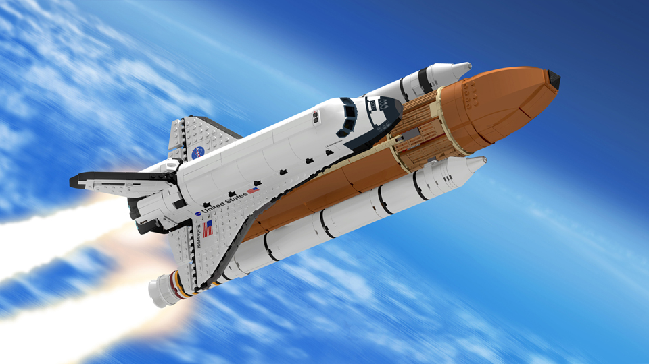
Year 5 Autumn 1 On the Space Station Curriculum Driver: Science

Slide 2
Year 5 Autumn 1 – On the Space Station Key Curriculum Driver: Science Other Curriculum Areas: History Rationale: On the Space Shuttle will give the children an in-depth insight into the Scientifics of Space, including forces, the solar system and the movements of the Earth and moon. By the end of this topic, most children will have: • The ability to think independently and raise questions about working scientifically and the knowledge and skills that it brings. • Confidence and competence in the full range of practical skills, taking the initiative in, for example, planning and carrying out scientific investigations. • Excellent scientific knowledge and understanding which is demonstrated in written and verbal explanations, solving challenging problems and reporting scientific findings. • High levels of originality, imagination or innovation in the application of skills. • The ability to undertake practical work in a variety of contexts, including fieldwork. • A passion for science and its application in past, present and future technologies. Children’s knowledge will be shown by: Extended Writing Outcomes: A persuasion text (This could be an advert for a trip to the moon) A finding tale(This could be an adventure where they land on a planet and make alien findings) Purposeful Topic Outcome: Create a podcast persuading people of an alien invasion. Use this as a stimulus for a persuasive piece of writing.

Slide 3
Year 5 Autumn 1 – On the Space Station
Subject | Objective
Science | Plan enquiries, including recognising and controlling variables where necessary. Use appropriate techniques, apparatus, and materials during fieldwork and laboratory work. Take measurements, using a range of scientific equipment, with increasing accuracy and precision. Record data and results of increasing complexity using scientific diagrams and labels, classification keys, tables, bar and line graphs, and models. Report findings from enquiries, including oral and written explanations of results, explanations involving causal relationships, and conclusions. Present findings in written form, displays and other presentations. Use test results to make predictions to set up further comparative and fair tests. Explain that unsupported objects fall towards the Earth because of the force of gravity acting between the Earth and the falling object. Identify the effect of drag forces, such as air resistance, water resistance and friction that act between moving surfaces. Describe, in terms of drag forces, why moving objects that are not driven tend to slow down. Understand that force and motion can be transferred through mechanical devices such as gears, pulleys, levers and springs. Understand that some mechanisms including levers, pulleys and gears, allow a smaller force to have a greater effect. Describe the movement of the Earth, and other planets, relative to the Sun in the solar system. Describe the movement of the Moon relative to the Earth. Describe the Sun, Earth and Moon as approximately spherical bodies. Use the idea of the Earth’s rotation to explain day and night and the apparent movement of the sun across the sky.

Slide 4
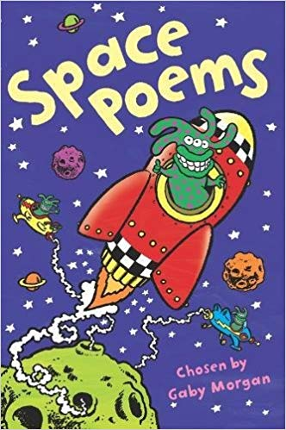
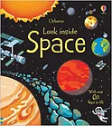
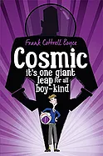
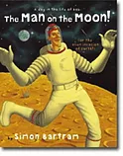
Topic Hook:
“Space Day” – build a rocket, watch space clips, outdoor rocket launch
Bryan Cox – The Planets
Topic Overview
On the Space Station
Curriculum Driver: Science
Topic Outcome
“Documentary” on Space for parents to watch. Script writing
Science Coverage (Main Focus)
Gravity and forces - drag forces, such as air resistance, water resistance and friction that act between moving surfaces. Working scientifically. Galileo vs Aristotle– Gravity experiments
Phases of the moon
Relationship between the sun and the earth – rotations, days, years etc. Create sun dials (DT link).
Fruit planets – size and distance between planets – work outside to place "planets" across field/playground, measuring distances in between each to show how close planets are to each other and to the sun.
- build a rocket – DT & art – use of recyclable materials to create a rocket that will be launched.
Space art – Peter Thorpe inspired abstract rocket art/collage
Free Writing Stimulus
Show the first moon landing – social media post, letter, diary, blog, newspaper article, story, recount.
Extended Writing Genres and Activities
Biography on Neil Armstrong – use resources from previous years to support this.
Script writing – documentary – watch David Attenborough documentaries to see how he narrates – running commentary. Chn to act out moon scene to write script to (could this be in topic on afternoon?)
Diary from the moon
Planet description – personification
A persuasion text – advert to the moon or UFO encounter
Trips and Experiences
See Hook and Outcome
Possible planetarium – too expensive?
Other subject Coverage
History – key people Neil Armstrong
Guided Reading – Man on the Moon (?) easier to read but lots of inference, prediction and retrieval.
Art & Dt – building rocket for Science launch.
Linked Texts

