Slide 1
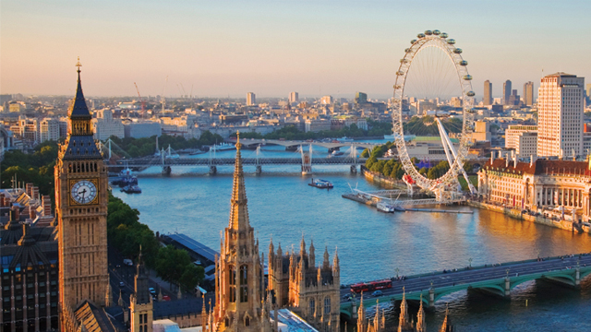
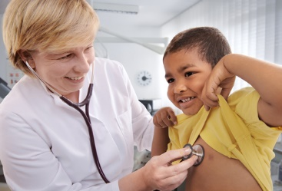
Year 2 Autumn 1 In the Capital Curriculum Driver: History

Slide 2
Year 2 Autumn 1 – In the Capital Key Curriculum Driver: History Other Curriculum Areas: … Rationale: In the Capital will give the children the opportunity to become historians and investigate the capital city in the context of the Great Fire of London. By the end of this topic, most children will: •Observe or handle evidence to ask questions and find answers to questions about the past. • Ask questions such as: What was it like for people? What happened? How long ago? • Use artefacts, pictures, stories, online sources and databases to find out about the past. • Identify some of the different ways the past has been represented. Describe historical events. • Recognise that there are reasons why people in the past acted as they did. Show an understanding of the concept of nation and a nation’s history. • Show an understanding of concepts such as civilisation, monarchy, parliament, democracy, and war and peace. Children’s knowledge will be shown by: Extended Writing: Letter writing Diary entry Non-chronological report/Newspaper report Purposeful Outcome: Making comparisons between modern day London and past London. Experiencing a fire – setting own models of houses alight.

Slide 3
Year 2 Autumn 1 – In the Capital
Subject | Objective
History | •Observe or handle evidence to ask questions and find answers to questions about the past. • Ask questions such as: What was it like for people? What happened? How long ago? • Use artefacts, pictures, stories, online sources and databases to find out about the past. • Identify some of the different ways the past has been represented. Describe historical events. • Recognise that there are reasons why people in the past acted as they did. Show an understanding of the concept of nation and a nation’s history. • Show an understanding of concepts such as civilisation, monarchy, parliament, democracy, and war and peace.

Slide 4
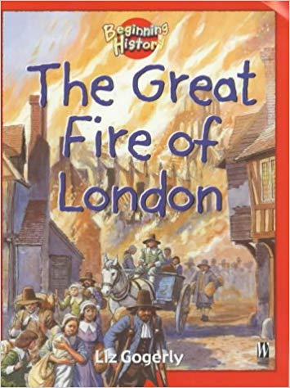
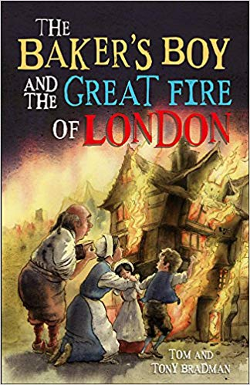
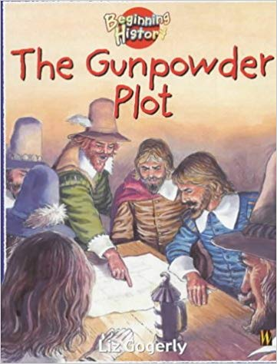
Topic Overview
Topic Outcome
Making comparisons between modern day London and past London. Focusing on materials of buildings etc – burning models that children have created.
Topic Hook
Food technology – making own bread and tasting.
In the Capital
Curriculum Driver
In the Capital Coverage (Main Focus)
HOOK – Food technology – following instructions and measuring/weighing ingredients to make bread. Taste testing afterwards. PSHE – health and safety (food safety).
Geography – Where is London? Where is the United Kingdom? Introduce children to using an atlas/map. Computing – use of Google Earth to visit/identify London/Leeds/Bramley.
Design Technology – design and create own models of houses that were around during Great Fire of London. Science – discuss materials and the changes in them. Final Outcome – experience a fire – set models on fire in playground.
Geography/History – Modern day London. Looking at key figures/monuments of London. I.e. Big Ben, London Eye, Houses of Parliament and Buckingham Palace. Identify, label and describe all 4 key monuments. Focus on Royal Family – discuss monarchy. Create a family tree for the Royal Family. Write a letter to a member of the Royal Family. Hot seating/role play – questions for the Queen/Prince William/Harry etc.
History – timeline of events in Fire of London. Timeline of events in Gunpowder Plot. Hot seating Guy Fawkes/Samuel Peeps.
PSHE – Create a fire safety poster – relating to Bonfire Night/Fire of London.
Free Writing Stimulus
Descriptive writing using 5 senses – pictures of Great Fire of London/fire.
Video of fire – what can you hear/see etc.
Light candle – what can you feel/smell.
Extended Writing Genres and Activities
Letter writing
Information text
Diary
Trips and Experiences
Fire brigade
Setting fire to houses
Baking bread
Presentation to Yr 1
Role play
Other subject Coverage
List activities
Food Technology – Following a set of instructions/recipe, measuring ingredients and cooking to make bread.
Geography – atlas skills, looking at a map of the United Kingdom, comparing London to where we live.
Design Technology – Designing and creating their own house from the Great Fire of London.
Linked Texts

