Slide 1
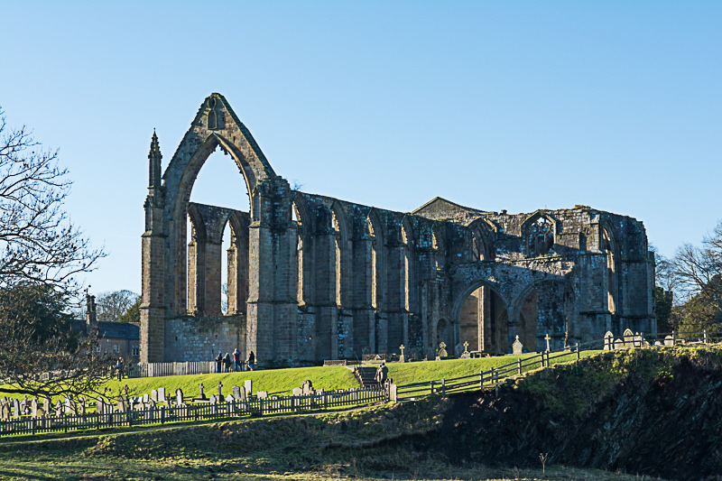
Year 5 Spring 1 At the Abbey Curriculum Driver: History

Slide 2
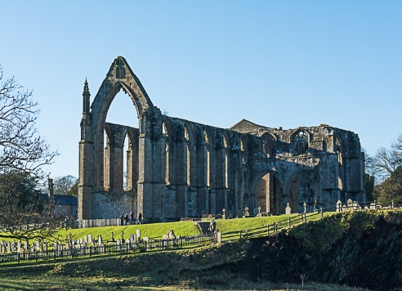
Year 5 Spring 1 – At the Abbey Key Curriculum Driver: History Other Curriculum Areas: Rationale: At the Abbey will give children an in-depth insight into Tudor life. They will investigate as historians and develop an overview of Tudor life, including; social, ethnic, cultural or religious diversity, ideas, beliefs, attitudes and experiences – as stated in the National Curriculum. By the end of this topic, most children will: • Use sources of evidence to deduce information about the past. • Select suitable sources of evidence, giving reasons for choices. • Use sources of information to form testable hypotheses about the past. • Seek out and analyse a wide range of evidence in order to justify claims about the past. • Show an awareness of the concept of propaganda and how historians must understand the social context of evidence studied. • Understand that no single source of evidence gives the full answer to questions about the past. • Refine lines of enquiry as appropriate. • Identify continuity and change in the history of the locality of the school. • Give a broad overview of life in Britain from medieval until the Tudor and Stuarts times. • Describe the social, ethnic, cultural or religious diversity of past society. • Describe the characteristic features of the past, including ideas, beliefs, attitudes and experiences of men, women and children. • Describe the main changes in a period of history (using terms such as: social, religious, political, technological and cultural). • Identify periods of rapid change in history and contrast them with times of relatively little change. • Understand the concepts of continuity and change over time, representing them, along with evidence, on a time line. • Use dates and terms accurately in describing events • Use appropriate historical vocabulary to communicate, including: • dates, time period, era, chronology, continuity, change, century, decade and legacy. • Use literacy, numeracy and computing skills to a exceptional standard in order to use original ways to present information and ideas. Children’s knowledge will be shown by: Extended Writing: An instruction text-How to create a medicine on how to cure the plague A Cinquain poem- based on the shared reading of Highwayman and other period poems. A meeting tale (Possibly linked to a significant person e.g. Henry VIII) Purposeful Outcome – A trip to Kirkstall Abbey to accumulate learning

Slide 3
Year 5 Spring 1– At the Abbey Essential Outcomes Covered
Subject | Milestone
History | • Use sources of evidence to deduce information about the past. • Select suitable sources of evidence, giving reasons for choices. • Use sources of information to form testable hypotheses about the past. • Seek out and analyse a wide range of evidence in order to justify claims about the past. • Show an awareness of the concept of propaganda and how historians must understand the social context of evidence studied. • Understand that no single source of evidence gives the full answer to questions about the past. • Refine lines of enquiry as appropriate. • Identify continuity and change in the history of the locality of the school. • Give a broad overview of life in Britain from medieval until the Tudor and Stuarts times. • Describe the social, ethnic, cultural or religious diversity of past society. • Describe the characteristic features of the past, including ideas, beliefs, attitudes and experiences of men, women and children. • Describe the main changes in a period of history (using terms such as: social, religious, political, technological and cultural). • Identify periods of rapid change in history and contrast them with times of relatively little change. • Understand the concepts of continuity and change over time, representing them, along with evidence, on a time line. • Use dates and terms accurately in describing events • Use appropriate historical vocabulary to communicate, including: • dates, time period, era, chronology, continuity, change, century, decade and legacy. • Use literacy, numeracy and computing skills to a exceptional standard in order to • Use original ways to present information and ideas.

Slide 4
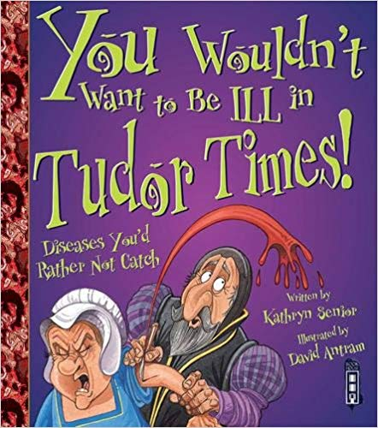
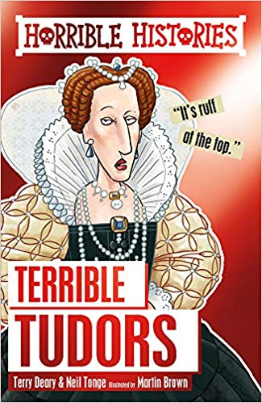
Topic Overview
Topic Hook
Make tudor houses as a 3D model and paint these.
Tudor art to create timetline.
At the Abbey
Curriculum Driver: History
Topic Outcome:
Trip to the abbey at Kirkstall and to apply the knowledge they have learnt throughout the topic.
History Coverage (Main Focus)
Children will be given a range of evidence about the life in the abbey and must make reasoned arguments and deductions based on this, as to what life was like in the past. A similar activity will be presented to the chn regarding Henry Viiii and chn must draw their own conclusions based on the evidence presented. Chn can question the evidence and its source but must suggest (and then research) alternative forms of evidence.
Chn will create a general timeline of the main events of the Tudor period and look at the significance of them. Exploring the main changes in the period with regard to the social, ethnic, cultural or religious diversity of the time.
The chn will present the information in a non-chronological report style through short burst writing activities to write about and show their understanding of: the main changes in the time period; the chronology of events and the legacy of the Tudors.
Children will create their own own tudor houses linked to their learning about daily tudor life.
Free Writing Stimulus
Children will also write a recount of their trip to Kirkstall Abbey. However, this could be done through a variety of ways:
It could be a newspaper article, diary extract, poem, recount, letter. Children will have a variety of photographs as memory joggers to help remember and sequence the events before they begin to write.
Extended Writing Genres and Activities The children will use their knowledge of Henry VIII and instruction writing to create a cure for the plague and test these instructions
Through a series of short burst writing opportunities, the children will explain the main changes of the period and the legacy of the Tudors.
Trips and Experiences
The launch of the topic begins with an art day where children create their own tudor house.
Children will visit Kirkstall Abbey.
Other subject Coverage
Shared and Guided Reading- introduce a range of period poetry- Highwayman, the raven. Children to explore the genre. During, writing sessions children will use the stimulus to recreate their own poems from this.
During the unit we will also look at mapping skills as Henry VIII’s relationships with foreign Queens sought strategic alliances and why this was.
Art- sketching of the abbey whilst we are at the abbey and creating tudor houses.
Linked Texts

