Slide 1
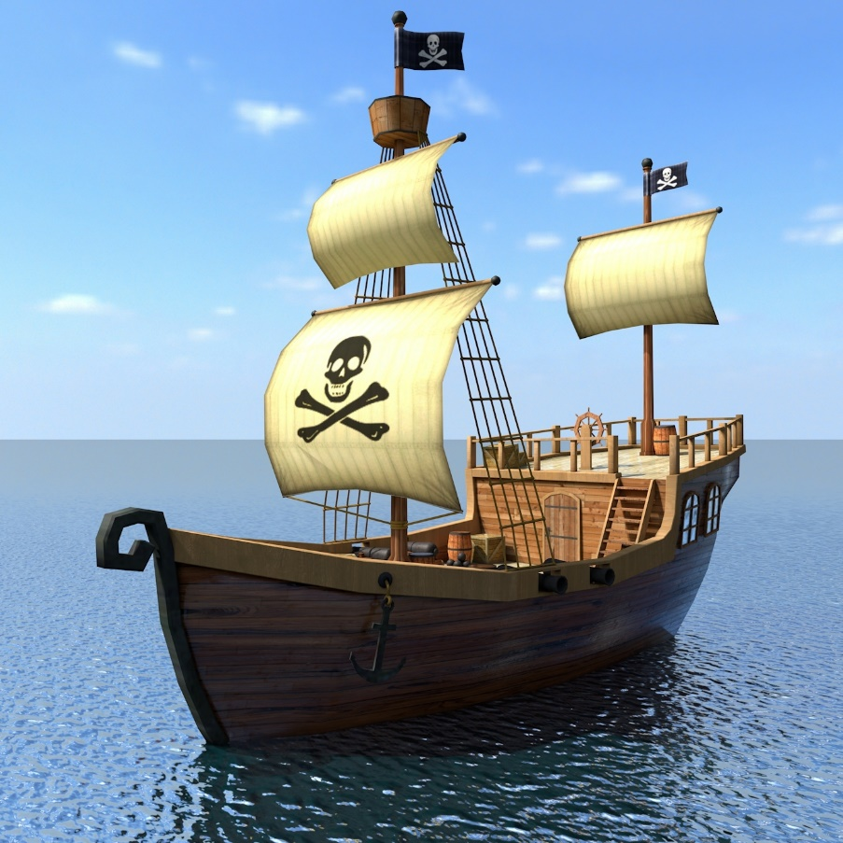
Year 2 Spring 1 On the High Seas Curriculum Driver: History

Slide 2
Year 2 Spring 1 – On the High Seas Key Curriculum Driver: History Other Curriculum Areas: … Rationale: On the High Seas will give the children the opportunity to become explorers of both land and sea! Children will learn of famous historical people as well as building on their knowledge of the worlds continents and oceans. By the end of this topic, most children will: • Ask questions such as: What was it like for people? What happened? How long ago? • Use artefacts, pictures, stories, online sources and databases to find out about the past. • Identify some of the different ways the past has been represented. Describe historical events. • Recognise that there are reasons why people in the past acted as they did. Name and locate the world’s continents and oceans. Use world maps, atlases and globes to identify the United Children’s knowledge will be shown by: Extended Writing: Sea shanty How to be a good pirate guide Purposeful Outcome: Learning about explorers such as Christopher Columbas. Understanding where we live in the world – in regards to the worlds continents and oceans.

Slide 3
Year 2 Autumn 1 – In the Capital
Subject | Objective
History Geography | • Ask questions such as: What was it like for people? What happened? How long ago? • Use artefacts, pictures, stories, online sources and databases to find out about the past. Describe historical events. • Recognise that there are reasons why people in the past acted as they did. Show an understanding of the concept of nation and a nation’s history. • Show an understanding of concepts such as civilisation, monarchy, parliament, democracy, and war and peace. Ask and answer geographical questions (such as: What is this place like? What or who will I see in this place? What do people do in this place?) Name and locate the world’s continents and oceans. Use world maps, atlases and globes to identify the United Kingdom and its countries, continents and oceans studied. Name, locate and identify characteristics of the four countries and capital cities of the United Kingdom and its surrounding seas. Understand geographical similarities and differences through studying the human and physical geography of a small area of the United Kingdom of a contrasting non-European country. Use basic geographical vocabulary to refer to key physical features including beach, coast, forest, hill, mountain, ocean, river, soil, valley, vegetation and weather. Use key human features, including: city, town, village, factory, farm, house, office and shop. Use compass directions (north, south, east and west) and locational language (e.g. near and far) to describe the location of features and routes on a map. Devise a simple map; and use and construct basic symbols in a key. Use simple grid references (A1, B1).

Slide 4
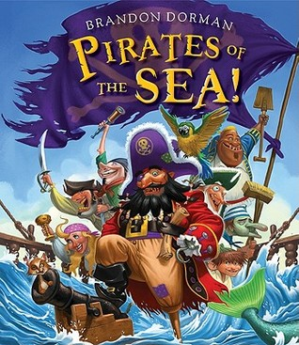
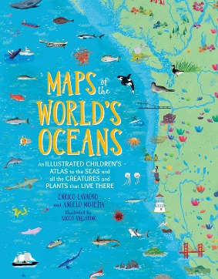
Topic Overview
Topic Outcome
Identifying and learning about famous historical people. Identifying the oceans of the world and being able to confidently use a range of geographical vocabulary.
Topic Hook
Drama – setting class up as a pirate ship and taking on one of the roles on board.
On the High Seas
Curriculum Driver
In the Capital Coverage (Main Focus)
HOOK – Drama – setting class up as a pirate ship and taking on one of the roles of the crew.
Geography – What are the worlds oceans? Where are they? Where are we in the world?
Science – which material is the best to build a waterproof pirate ship/flag out of?
History – learning about famous explorers such as Christopher Columbus.
History – learning about famous pirates such as Blackbeard.
Geography – creating and using maps for a known area. Using geographical vocabulary and symbols whilst doing so. Using a compass to identify north, east, south and west.
Art – sketching a pirate ship in detail.
Free Writing Stimulus
Descriptive writing – creating/designing their own pirate.
Extended Writing Genres and Activities
How to be a good Pirate guide
Wanted Poster
Sea shanty
Trips and Experiences
Role play
Trip to the Royal Armories
Other subject Coverage
List activities
Art– sketching skills of a pirate ship/pirate flag.
Geography – atlas skills, looking at a map of the world and identifying the different oceans.
Science– Working scientifically, experimenting to find the best materials for a waterproof pirate ship/flag.
Linked Texts

