Slide 1
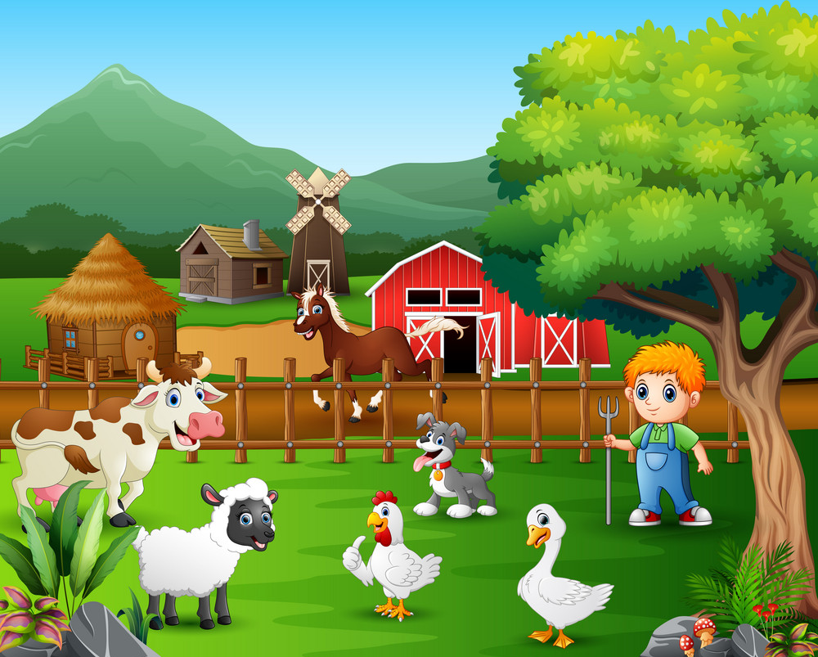
Year 3 Spring 2 On The Farm Curriculum Driver: Science – plants DT - Food

Slide 2
Year 3 Autumn 2 – On The Farm Key Curriculum Driver: Science Other Curriculum Areas: DT Rationale: On The Farm will provide the opportunity for children to explore the role of flowers in the life cycle of flowering plants, including pollination, seed formation and seed dispersal, Identify and describe the functions of different parts of flowering plants: roots, stem, leaves and flowers. • Explore the requirements of plants for life and growth (air, light, water, nutrients from soil, and room to grow) and how they vary from plant to plant. • Investigate the way in which water is transported within plants. By the end of this topic, most children will have: The ability to think independently and raise questions about working scientifically and the knowledge and skills that it brings. • Have confidence and competence in a full range of practical skills, taking the initiative in, for example, planning and carrying out scientific investigations. • Excellent scientific knowledge and understanding which is demonstrated in written and verbal explanations, solving challenging problems and reporting scientific findings. • High levels of originality, imagination or innovation in the application of skills. • A passion for science and its application in past, present and future technologies. Design with purpose by identifying opportunities to design. • Make products by working efficiently (such as by carefully selecting materials). • Refine work and techniques as work progresses, continually evaluating the product design. • Improve upon existing designs, giving reasons for choices. Children’s knowledge will be shown by: Extended Writing: English - Persuasive writing for buying your toy. Fact file – pick a toy to create a fact file about. How does it work? Children’s own research of the Best toys. What can you Find out? What do you know? Persuasive poster for toy.

Slide 3
Year 3 Autumn 2 – At The Toy Shop Chris Quigley Milestones Covered
Subject | Milestone
Science | • Ask relevant questions. • Set up simple, practical enquiries and comparative and fair tests. • Make accurate measurements using standard units, using a range of equipment, e.g. thermometers and data loggers. • Gather, record, classify and present data in a variety of ways to help in answering questions. • Record findings using simple scientific language, drawings, labelled diagrams, bar charts and tables. • Report on findings from enquiries, including oral and written explanations, displays or presentations of results and conclusions. • Use results to draw simple conclusions and suggest improvements, new questions and predictions for setting up further tests. • Identify differences, similarities or changes related to simple, scientific ideas and processes. • Use straightforward, scientific evidence to answer questions or to support their findings. Identify and describe the functions of different parts of flowering plants: roots, stem, leaves and flowers. • Explore the requirements of plants for life and growth (air, light, water, nutrients from soil, and room to grow) and how they vary from plant to plant. • Investigate the way in which water is transported within plants. • Explore the role of flowers in the life cycle of flowering plants, including pollination, seed formation and seed dispersal.
DT | • Cut materials accurately and safely by selecting appropriate tools. • Measure and mark out to the nearest millimetre. • Apply appropriate cutting and shaping techniques that include cuts within the perimeter of the material (such as slots or cut outs). • Select appropriate joining techniques Create series and parallel circuits • Understand the need for a seam allowance. • Join textiles with appropriate stitching. • Select the most appropriate techniques to decorate textiles. Control and monitor models using software designed for this purpose. Choose suitable techniques to construct products or to repair items. • Strengthen materials using suitable techniques. • Design with purpose by identifying opportunities to design. • Make products by working efficiently (such as by carefully selecting materials). • Refine work and techniques as work progresses, continually evaluating the product design. • Improve upon existing designs, giving reasons for choices. • Disassemble products to understand how they work. Identify some of the great designers in all of the areas of study (including pioneers in horticultural techniques) to generate ideas for designs.

Slide 4
Topic Overview
Topic Hook
School trip to a farm.
Title: On The Farm
Curriculum Driver: Science and DT
Topic Outcome
Explore the plant’s lifecycle and the need for air, water and sunlight and to have investigated how water travels through roots.
Science Coverage (Main Focus)
Begin topic with a visit to a farm – looking at plants and animals and their lifecycles.
Investigate how plants survive and conduct an experiment where plants are put into different environment to see if they can survive.
Label and understand the different parts of a plant.
Investigate food that humans eat and food that animals eat and the differences between the two.
Look at how farms grow foods and how they are different to the foods you buy from the supermarket. Have they come from a local farm? Or are they shipped worldwide?
Investigate the names of animals and their lifecycles.
Investigate animals that grow up on farms, what happens to them? why does this happen? Is it important for our food chain? Are there alternative ways to live?
Plant fact files. What information have you gathered?
DT – eating foods from local farms. Do they taste better than some foods we buy from the supermarket? Why? Why not? Investigate why you think they are different. Is it environmentally more sustainable to boy from a local farm than buying from the supermarket? Why do you think this?
Children’s own research about
farms. Are all farms good?
Create for and against argument
For factory farms.
Free Writing Stimulus
Extended Writing Genres and Activities
Fact file –a plant fact file. What have you found out about plants?
Can you compare one plant to another? Are they different? How are they the same?
Trips and Experiences
Visit a farm
Plant flowers in our garden
Other subject Coverage
Art – sketch a plant. Can you label their parts too?
History – How has farming changed over time? Can you compare farming in the past to farming now? What was farming like in Leeds in the past?
Geography – Farming around the world. How does it change from country to country? Do all farmers farm the same? Do they grow different food?
Music – ukuleles every Tuesday.
Linked Texts

