Slide 1
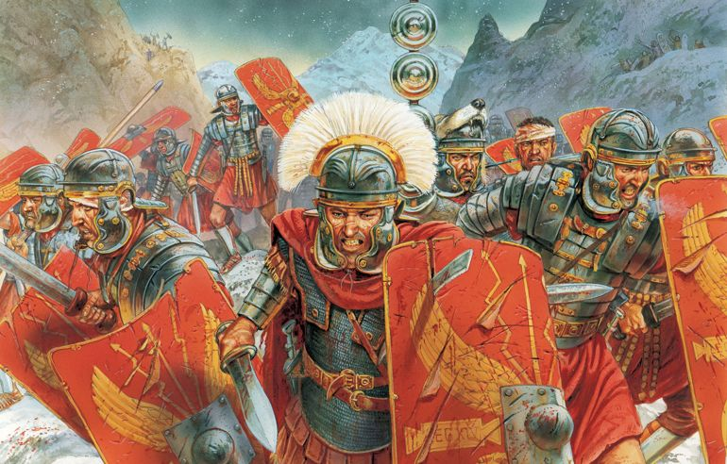
Year 4 Spring 2 Rome Curriculum Driver: History

Slide 2
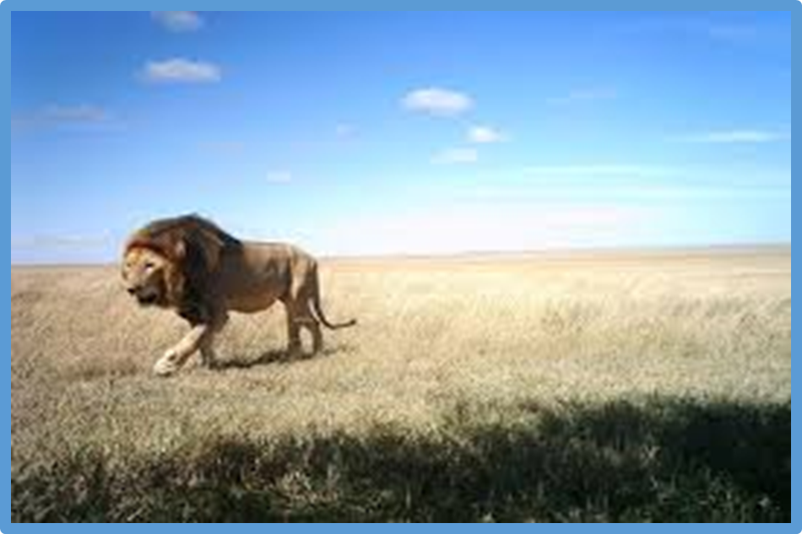
Year 4 Spring 2- In Rome Key Curriculum Driver: History Other Curriculum Areas: Rationale: The ‘In Rome’ topic will allow children to have the opportunity to explore the history of Rome, the chronology in relation to other periods of time and to build an overview of the world around them. By the end of this topic, most children will have: The ability to think independently and raise questions about working historically and the knowledge and skills that it brings. • High levels of originality, imagination or innovation in the application of skills. • The ability to undertake practical work in a variety of contexts, including fieldwork. • A passion for History and its application in past, present and future technologies.
• The ability to think critically about history and communicate ideas very confidently in styles appropriate to a range of audiences.
• The ability to think, reflect, debate, discuss and evaluate the past, formulating and refining questions and lines of enquiry. Children’s knowledge will be shown by: Extended Writing: Writing a job application to become a legionnaire.
Writing a diary entry from the point of view of a Roman child.
Writing as an estate agent to persuade people to buy a Roman house.
Purposeful Outcome – Children to create a leaflet about the life of a Roman.

Slide 3
Subject | Milestone
History | • Use evidence to ask questions and find answers to questions about the past. • Suggest suitable sources of evidence for historical enquiries. • Use more than one source of evidence for historical enquiry in order to gain a more accurate understanding of history. • Describe different accounts of a historical event, explaining some of the reasons why the accounts may differ. • Suggest causes and consequences of some of the main events and changes in history. Give a broad overview of life in Britain from ancient until medieval times. Give a broad overview of life in Britain from ancient until medieval times. • Compare some of the times studied with those of other areas of interest around the world. • Describe the social, ethnic, cultural or religious diversity of past society. • Describe the characteristic features of the past, including ideas, beliefs, attitudes and experiences of men, women and children. Place events, artefacts and historical figures on a timeline using dates. • Understand the concept of change over time, representing this, along with evidence, on a timeline. • Use dates and terms to describe events. • Use appropriate historical vocabulary to communicate, including: • dates • time period • era • change • chronology. • Use literacy, numeracy and computing skills to a good standard in order to communicate information about the past.

Slide 4
Topic Overview
Hook
Clay making of Roman pottery for a banquet.
Title: In Rome
Curriculum Driver: History
Topic Outcome
Children create a presentation on life as a Roman soldier.
Science Coverage (Main Focus)
List activities
Lesson 1: Hook lesson- making pottery with clay for Roman banquet.
Lesson 2: Geograpical position of where the Roman Empire took over.
Lesson 3: What did the Romans invent that we still use today?
Lesson 4: A day in the life of a Roman child. Roman numerals activity, make a speech and even learn a little bit of latin!
Lesson 5: Comparison of school in the Roman times and school in the modern day- piece of extended writing.
Lesson 6: Extended write- Diary entry of the life of a Roman child.
Lesson 7+8: What was life like for a Roman soldier? How do you become one? Children to write a job application form for becoming a legionnaire. Choose which rank you would like to be a part of and why you would most be suited for this.
Lesson 9: Roman housing- Compare how it is different to modern day life and also to one other period of time. Create a leaflet advertising to sell the Roman settlement. Use persuasive writing to entice people to want to buy it- Imagine you are an estate agent!
Lesson 10+11: Looking at the life of an important figure in history-Boudicca. Look at the story of Boudicca and how she was portrayed from a variety of different sources. What type of person do you think she was? How and why do you think she was so successful? Create a facebook memories timeline for Boudicca explaining all of her achievements. Debate lesson on why she was so successful.
Lesson 12: Was the Roman empire a good move for History? How did it affect us? Overall piece of writing to explain the historical importance of the Romans and how it has changed our life today.
Free Writing Stimulus
Diary Entry from the point of view of a Roman child. What was it like? Did they enjoy it in Rome?
Extended Writing Genres and Activities
Produce a newspaper / newsletter / leaflet to present findings.
News report / radio report to practise oracy skills.
Diary entry
Job applications
Trips and Experiences
Clay experience of making own pottery.
History museum in Leeds next half term to consolidate knowledge?
Other subject Coverage:
Art and DT- Clay making
Linked Texts:
The Thieves of Ostia- Caroline Lawrence
What Would the Romans do?
Romans on a Rampage- Jeremy Strong
Rotten Romans- Horrible histories

